Slide 1


GPUs II
Exam exercises

Slide 2

Agenda
Introduction and slight recall
Matrix multiplication
Exercises!

Slide 3
Intro
The exam takeover from the previous lesson

Slide 4
On the previous episode…
Blocks, threads, grid

Slide 5
On the previous episode…
Blocks, threads, grid
Compute capability

Slide 6
Threads
In CUDA, a logic thread = a physical core

Slide 7
Threads
In CUDA, a logic thread = a physical core
You can picture a thread as the smallest unit being executed at a time

Slide 8
Threads
In CUDA, a logic thread = a physical core
You can picture a thread as the smallest unit being executed at a time
We have a huge number of threads/cores and thus execution needs to group them under a logical structure
This ensure the parallelism of execution up to a certain point, thus this leads us towards…

Slide 9
Blocks
A block is a logical (and physical) group of threads

Slide 10
Blocks
A block is a logical (and physical) group of threads
They group many cores running inside the same SM

Slide 11
Blocks
A block is a logical (and physical) group of threads
They group many cores running inside the same SM
Instruction pointer is shared amongst them

Slide 12
Grid
Computation gets so big that another logical grouping is needed, the Grid

Slide 13
Grid
Computation gets so big that another logical grouping is needed, the Grid
The Grid is yet another logical grouping of Blocks

Slide 14
Take away from this
A thread is just an element of a block

Slide 15
Take away from this
A thread is just an element of a block
A block is an element of the grid

Slide 16
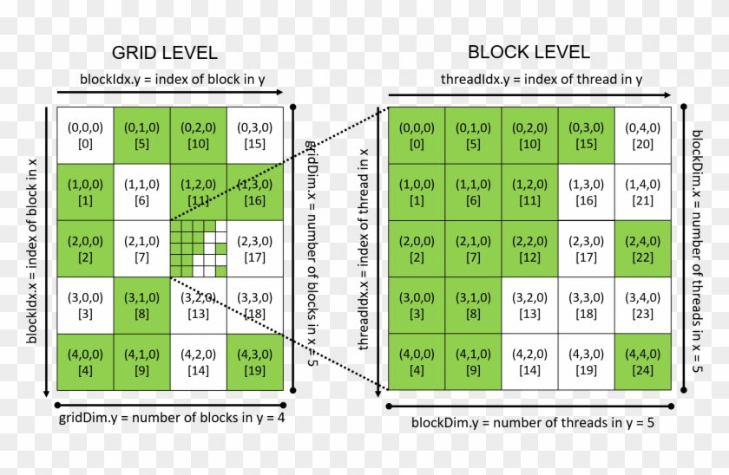
Take away from this
A thread is just an element of a block
A block is an element of the grid
Each of them uses 3d indexing
(Next slide is a full page on this image)

Slide 17
Indexing (z-axis misses for clarity)

Slide 18
Compute capability
Over the years new hardware was introduced and thus each GPU was differently capable than the previous one

Slide 19
Compute capability
Over the years new hardware was introduced and thus each GPU was differently capable than the previous one
This number represents the “power” of each device, the bigger, the better.

Slide 20
Matrix multiplication
The heart of 3d graphics

Slide 21
Rows times columns
Not a math class, but genuine question…

Slide 22
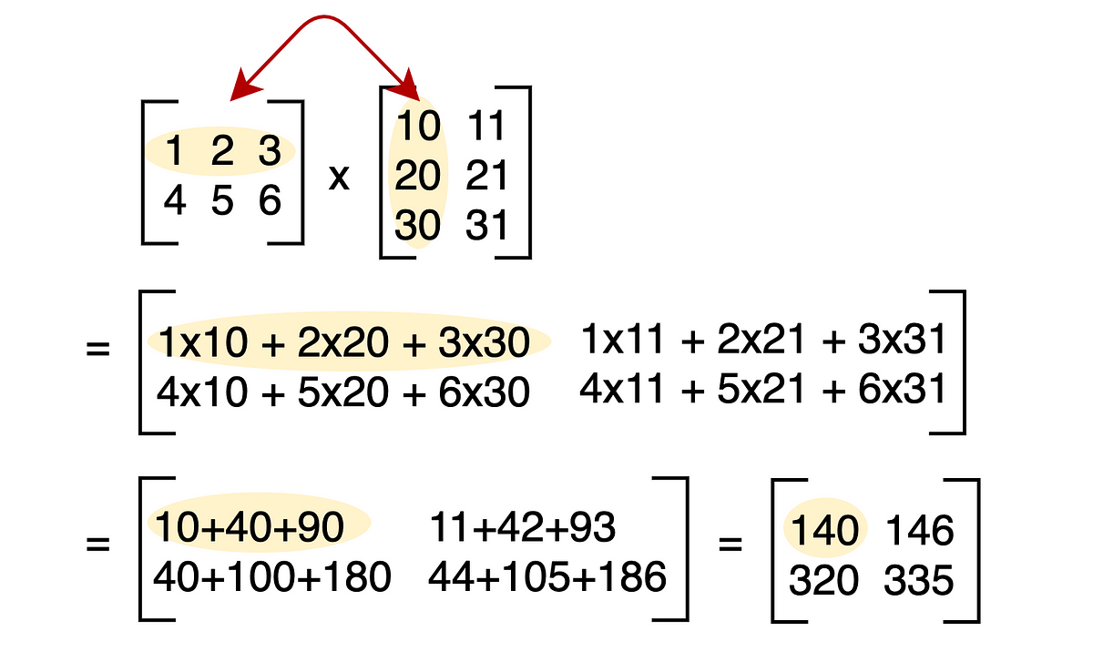
Rows times columns
Not a math class, but genuine question…
Why?

Slide 23
(Extra) try it yourself!
Write down two matrices (2x2 for simplicity)

Slide 24
(Extra) try it yourself!
Write down two matrices (2x2 for simplicity)
Compute a linear operator like Ax

Slide 25
(Extra) try it yourself!
Write down two matrices (2x2 for simplicity)
Compute a linear operator like Ax
Now apply B to the result like B(Ax)

Slide 26
(Extra) try it yourself!
Write down two matrices (2x2 for simplicity)
Compute a linear operator like Ax
Now apply B to the result like B(Ax)
In principle the result should be equal to the operation BA(x), you’ll see the formula naturally appear!

Slide 27
(Extra) try it yourself!
Write down two matrices (2x2 for simplicity)
Compute a linear operator like Ax
Now apply B to the result like B(Ax)
In principle the result should be equal to the operation BA(x), you’ll see the formula naturally appear!

Slide 28
This but faster
Each dot product depends on the previous result…

Slide 29
This but faster
Each dot product depends on the previous result…
…But each row times the column is independent!

Slide 30
This but faster
Each dot product depends on the previous result…
…But each row times the column is independent!
Same operation with different data, HUGE GPU playground

Slide 31
The slow implementation
void matrix_mul(int*a, int * b, int width, int height){
for(int i=0;i<width;i++)
for(int j=0;j<height;j++){
int sum=0;
for(int k=0;k<height;k++){
int a = A[i * width + k];
int b = B[k * height + j];
sum += a*b;
}
B[i*width+j]=sum;
}
}

Slide 32
Why is it slow?
~O(n^3)

Slide 33
Why is it slow?
~O(n^3)
For large matrices (100.000x100.000) this is already a problem

Slide 34
We can do better
The GPU implementation!
VSCODE incoming

Slide 35
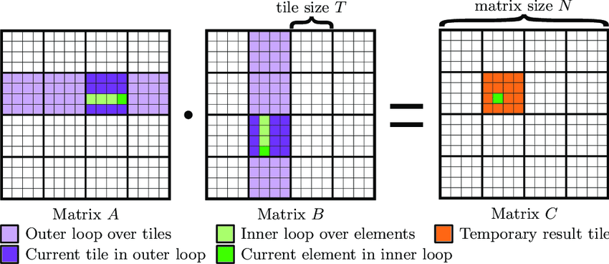
Tiling

Slide 36
Exercises
Past years exam exercises

Slide 37
Exercise 1, indexing
Describe how to obtain a unique ID for each thread by using the block ID and thread ID, in the case of a 2D grid and 3D blocks

Slide 38
Exercise 1, indexing
Describe how to obtain a unique ID for each thread by using the block ID and thread ID, in the case of a 2D grid and 3D blocks
ID = threadIdx.x +
blockDim.x * (threadIdx.y +
blockDim.y * (threadIdx.z +
blockDim.z * (blockIdx.x +
gridDim.x * blockIdx.y
)))

Slide 39
Exercise 2, thread scheduling
Assume a CUDA device allowing 8 blocks, 1024 threads per SM and 512 threads in each block
For matrix multiplication, should we use 8x8, 16x16 or 32x32?
Analyze the pros and cons of each choice

Slide 40
Exercise 2, thread scheduling
8x8
this means 8x8 = 64 threads per block
each SM have 1024 threads
1024 / 64 = 16 blocks, but we have 8 per SM

Slide 41
Exercise 2, thread scheduling
8x8
this means 8x8 = 64 threads per block
each SM have 1024 threads
1024 / 64 = 16 blocks, but we have 8 per SM
16x16
this means 16x16 = 256 threads per block
1024 / 256 = 4 blocks

Slide 42
Exercise 2, thread scheduling
8x8
this means 8x8 = 64 threads per block
each SM have 1024 threads
1024 / 64 = 16 blocks, but we have 8 per SM
16x16
this means 16x16 = 256 threads per block
1024 / 256 = 4 blocks
32x32
It’s not even schedulable

Slide 43
Exercise 3, gpu capabilities
You need to write a kernel that operates on an image represented by a matrix of size 1440x1280x24. You would like to assign one thread to each matrix element. You would like your thread blocks to use the maximum number of threads per block possible on your device.
How would you select the dimensions of a 2D grid and 2D rectangular blocks for your kernel, minimizing the number of idle threads? Consider a device having compute capability 1.3.
b) How would you select the dimensions of a 2D grid and 3D blocks with the three sides all equal for your kernel, minimizing the number of idle threads? Consider a device having compute capability 3.5

Slide 44
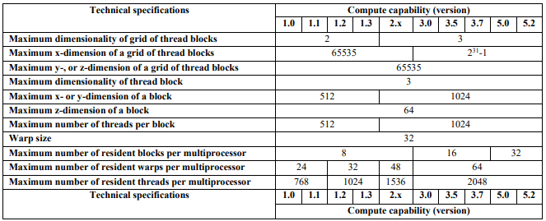
Exercise 3, gpu capabilities

Slide 45
Exercise 3, gpu capabilities
max block size = 512 = 2 ** 9
we can split in half
x = 2**4
y = 2**5
gridDim.x = 1440 / x = 90
gridDimy = (1280 * 24) / y = 960
We can do better with 2**3 and 2**6
gridDim.x = 180
gridDim.y = 480

Slide 46
Exercise 3, gpu capabilities
max block size = 1024 = 2 ** 10
we can split in three
x = 2**3
y = 2**4
z = 2**3
gridDim.x = 1440 / x = 180
gridDim.y = (1280 * 24) / (y * z) = 240

Slide 47
The End

